Slide 1



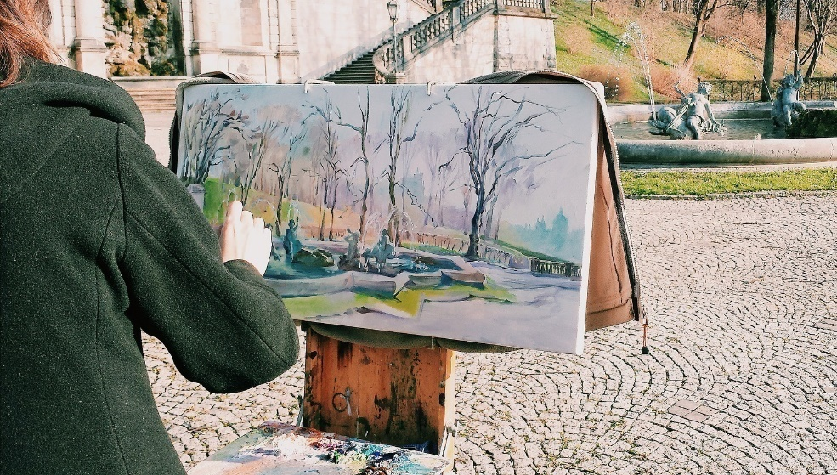
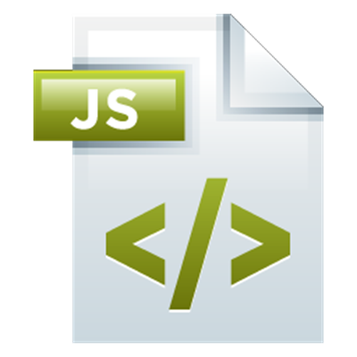
Game Development with JS and Canvas 2D
Simple Game Development with JS, Canvas 2D, DOM and Events
Canvas 2D
SoftUni Team
Technical Trainers
Software University
http://softuni.bg

Slide 2


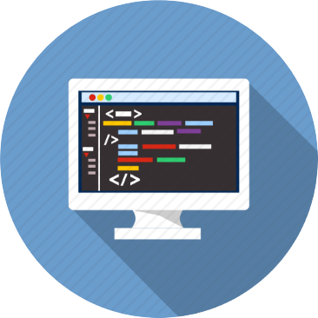
Table of Contents
Intro to Canvas 2D
Draw Figures, Text and Images
Simple Animations with Canvas
Handle Keyboard / Mouse Events
Creating a Game with Canvas Animation – Step by Step
The Game Loop, Animation, Collision Detection, Game Controls

Slide 3
Have a Question?
sli.do #JSCORE

Slide 4
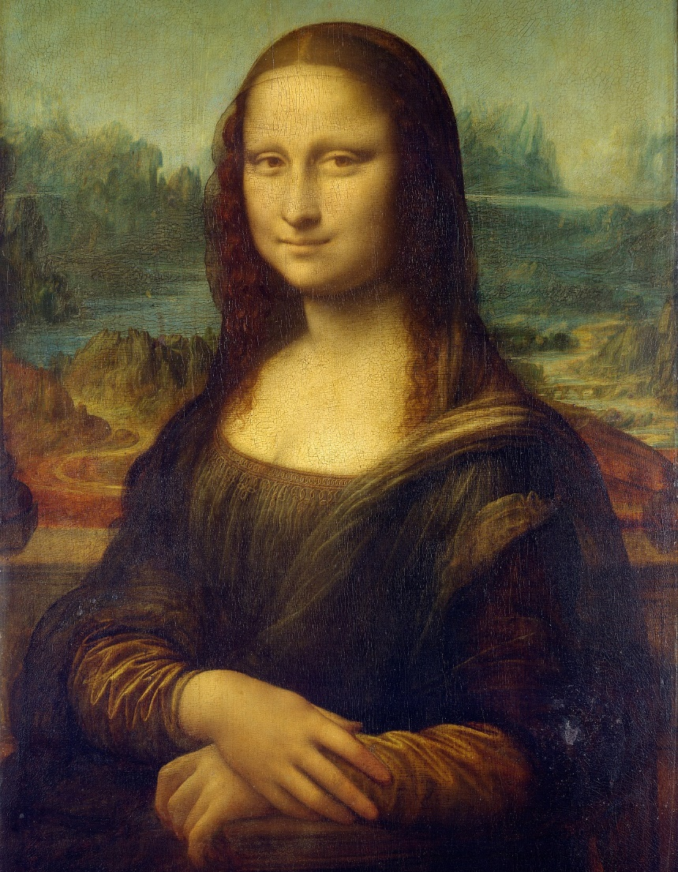
Introduction to Canvas 2D
Drawing Simple Figures

Slide 5
HTML5 Canvas API
A canvas is used to draw graphics inside a browser, using JS
Supports 2D and hardware-accelerated 3D via WebGL
Examples:
http://processingjs.org/
http://fabricjs.com/
https://playcanvas.com/play
Before HTML5, Flash was used for web graphics

Slide 6
HTML5 Canvas API (2)
Defined in HTML via the <canvas> tag:
Controlled with JavaScript via its context object:
Size of the canvas,
defined in pixels
Used by JavaScript for identification
<canvas width="800" height="600" id="canvas"></canvas>
let canvas = document.getElementById("canvas");
let ctx = canvas.getContext("2d“);

Slide 7
Drawing Shapes
The API offers built-in functions for drawing simple shapes
Simplest shape is a rectangle
Drawing parameters (color, linewidth) can be customized
Top-left corner
Dimensions
ctx.fillRect(x, y, width, height)

Slide 8
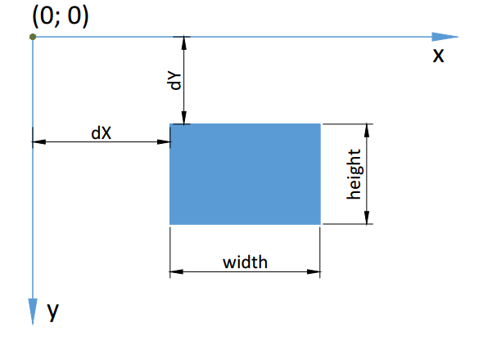
Canvas Coordinates
Coordinates (0; 0) at top-left

Slide 9
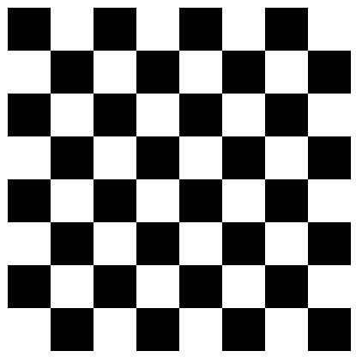
Example: Draw Checkerboard
for (let row = 0; row < 8; row++) {
for (let col = 0; col < 8; col++) {
if ((row + col) % 2 == 0) {
let x = 25 + col * 50;
let y = 25 + row * 50;
ctx.fillRect(x, y, 50, 50);
}
}
}

Slide 10
Drawing Shapes (2)
Lines and paths can be drawn with similar commands
ctx.beginPath(); // Start new shape
ctx.moveTo(x, y); // Move cursor
ctx.lineTo(x, y); // Draw line
ctx.closePath(); // Draw line to start
ctx.stroke(); // Apply outline
ctx.fill(); // Fill shape

Slide 11
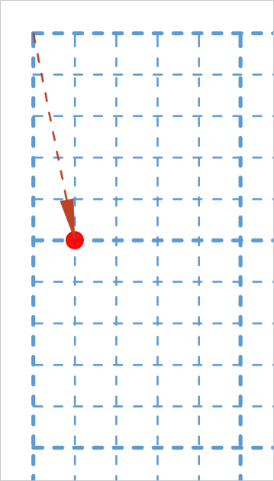
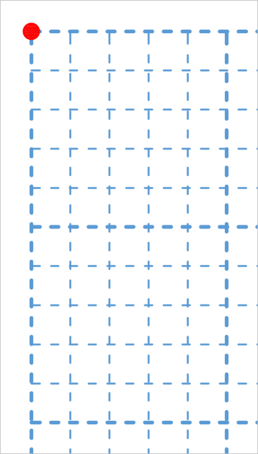
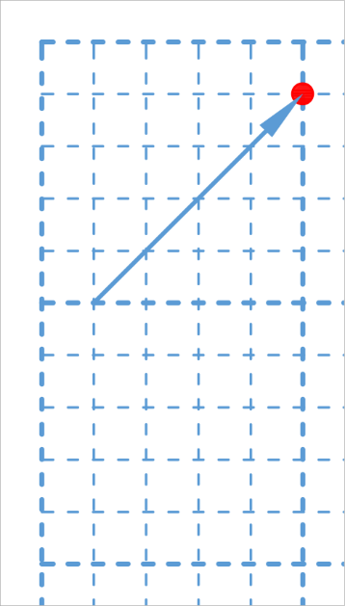
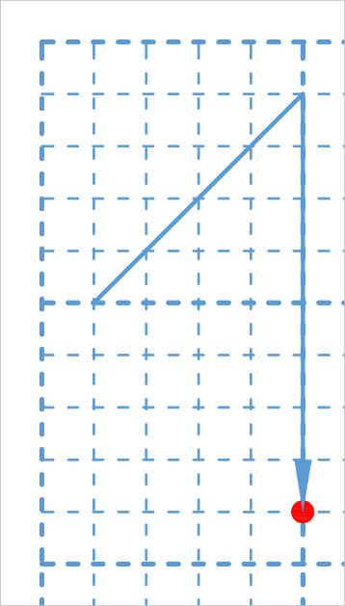
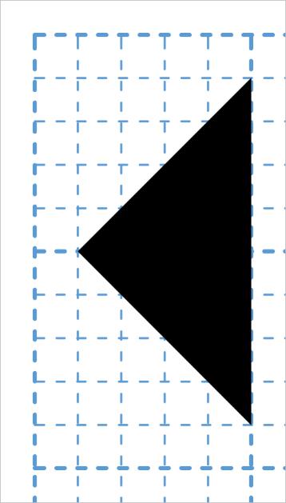
Example: Draw Figure
Draw triangle
ctx.beginPath();
ctx.moveTo(10,50);
ctx.lineTo(50,10);
ctx.lineTo(50,90);
ctx.fill();

Slide 12
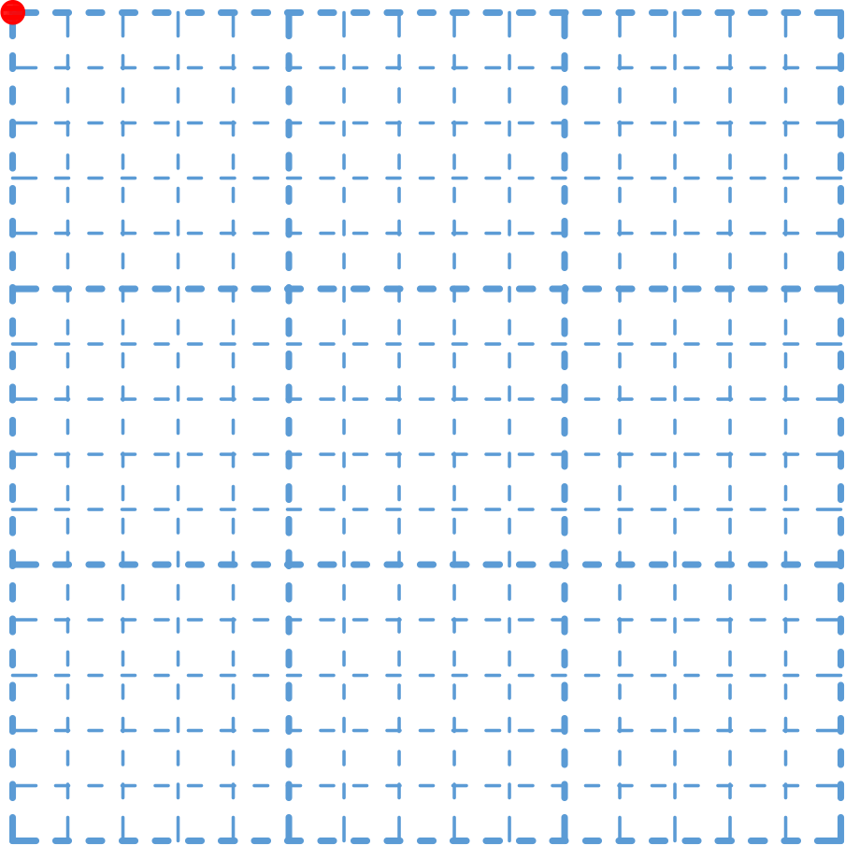
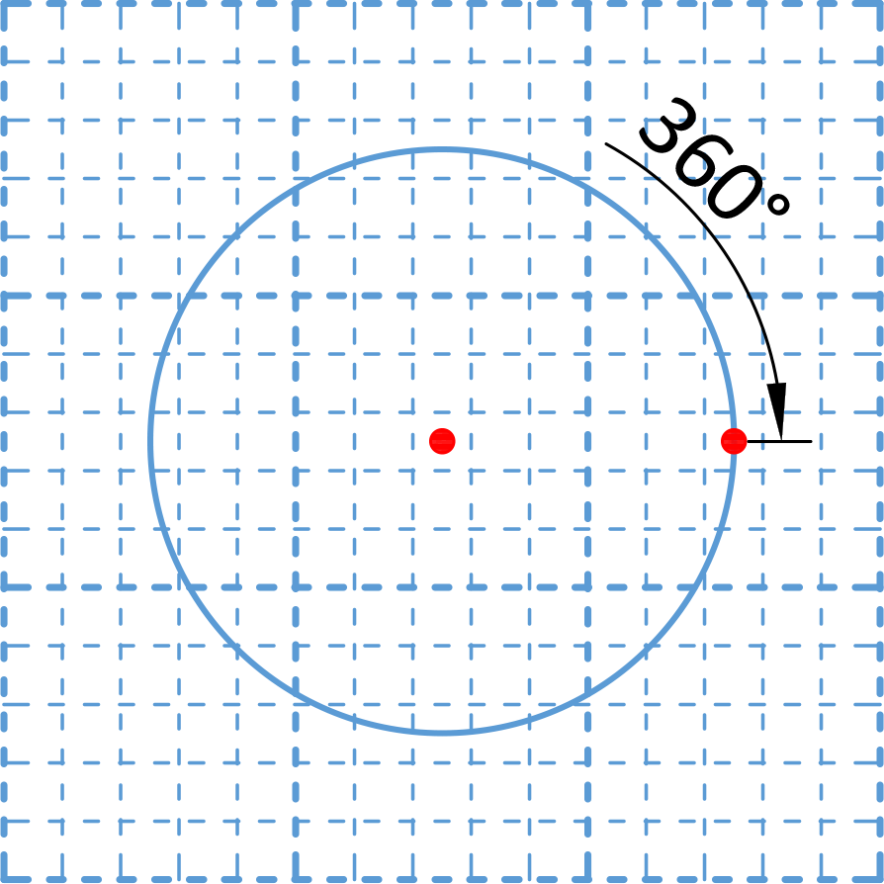
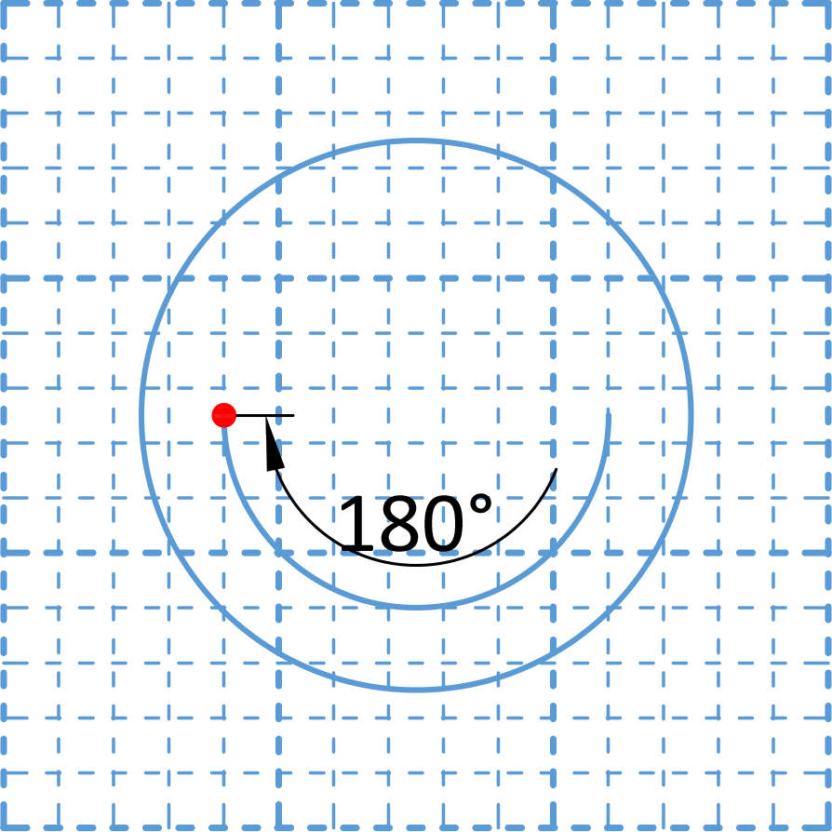
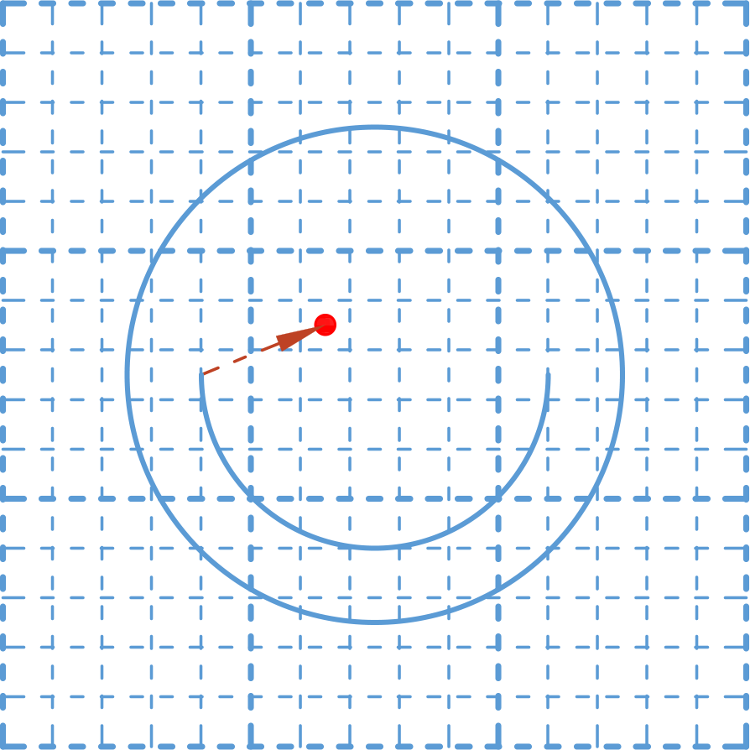
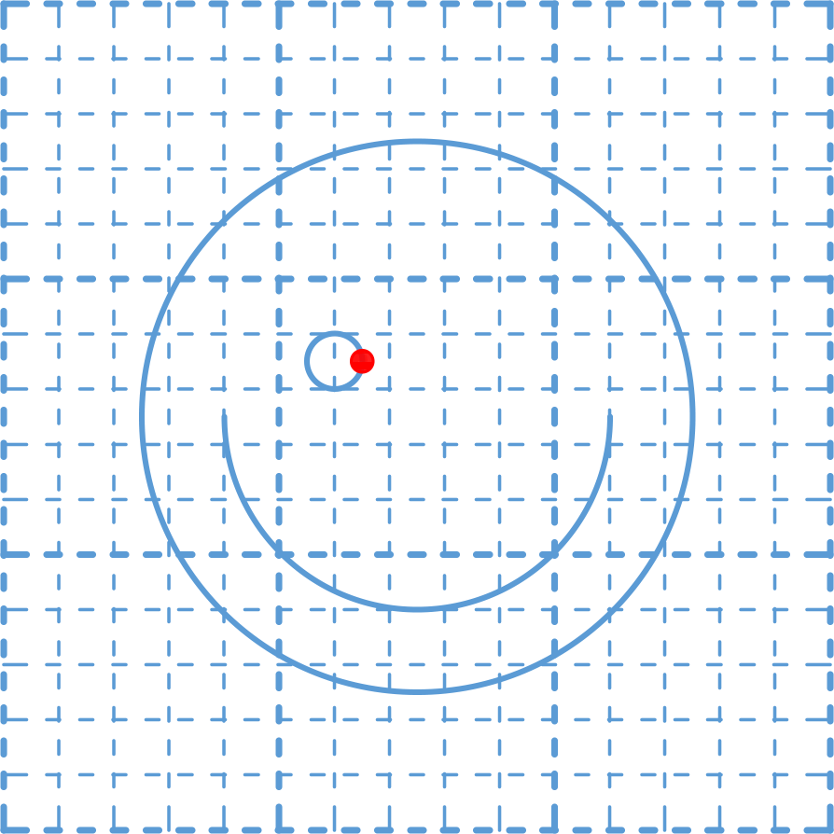
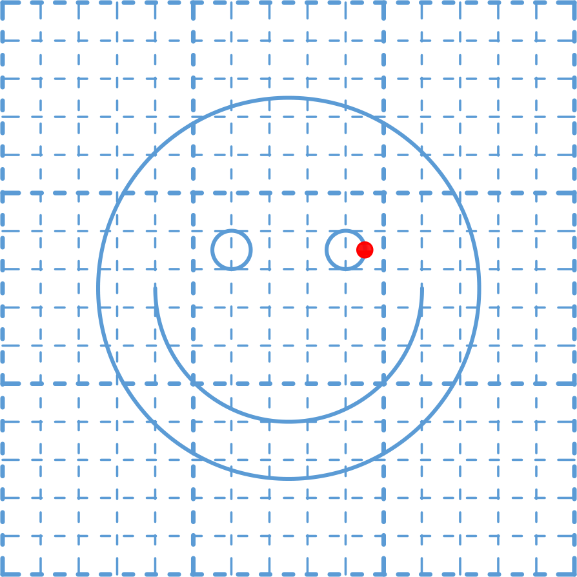
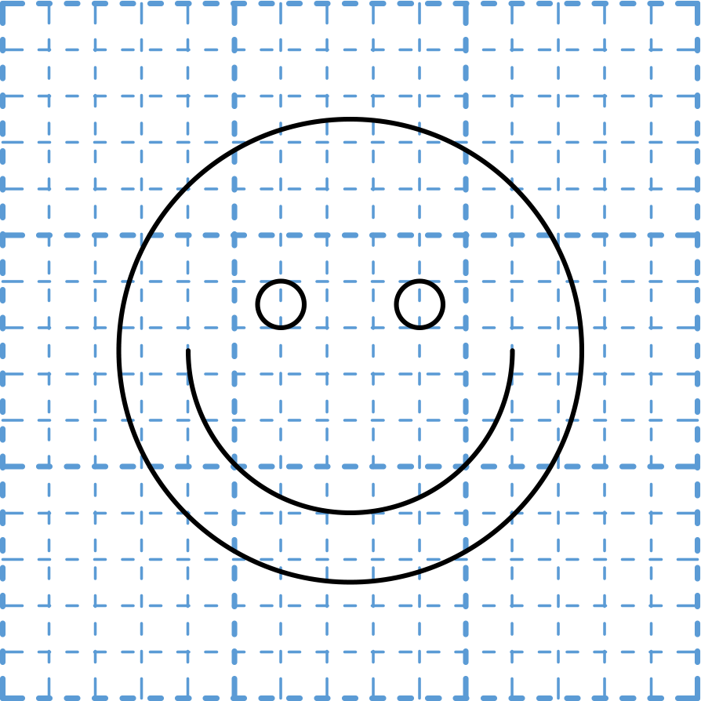
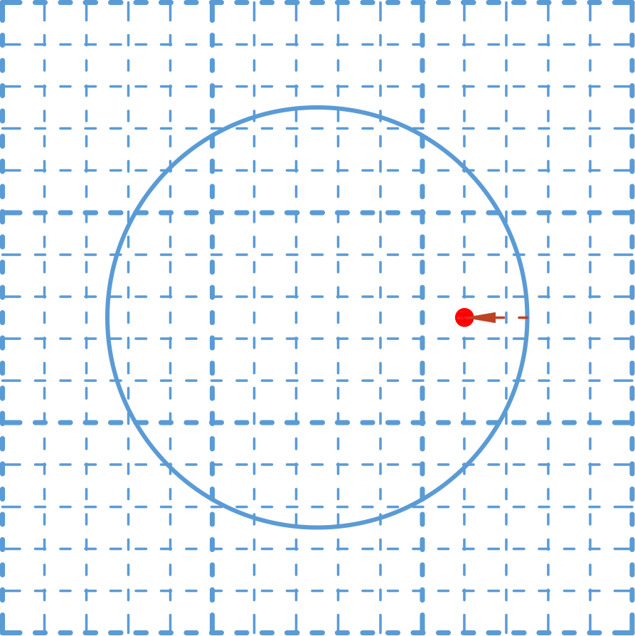
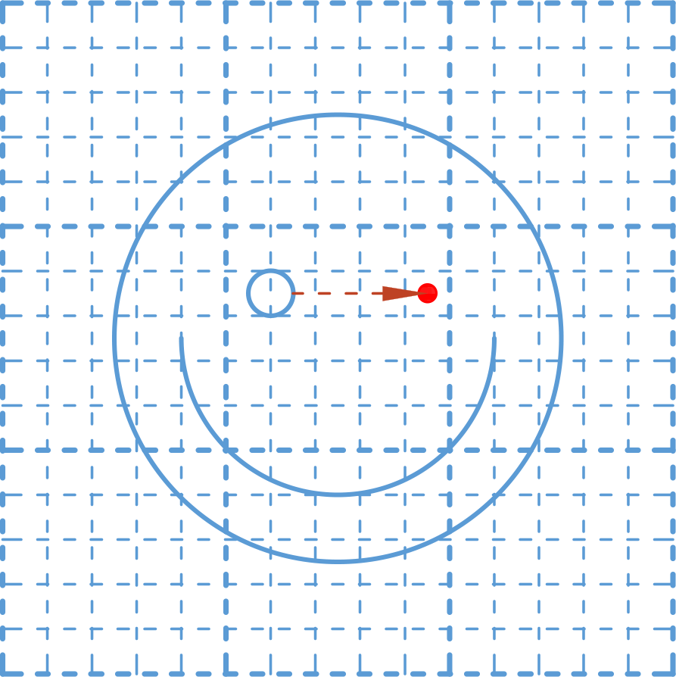
Example: Draw Figure (2)
Draw smiley face
ctx.beginPath();
ctx.arc(75,75,50,0,Math.PI*2,true);
ctx.moveTo(110,75);
ctx.arc(75,75,35,0,Math.PI,false);
ctx.moveTo(65,65);
ctx.arc(60,65,5,0,Math.PI*2,true);
ctx.moveTo(95,65);
ctx.arc(90,65,5,0,Math.PI*2,true);
ctx.stroke();

Slide 13
Using Colors And Patterns
The color and pattern of default shapes can be customized
Shape fill can be changed using ctx.fillStyle
Line color can be changed using ctx.strokeStyle
Valid formats are
Color string literals: 'black', 'red', 'orange', etc.
CSS Color: '#FFA500'
RGBA combination: 'rgba(255, 165, 0, 1)'

Slide 14
Line Styles
Line strokes can be further customized
lineWidth – changes width of line
lineCap – changes style of line ends
lineJoin – changes appearance of corners
setLineDash(segments) – changes the dash pattern
Dash patterns are defined as an array of lengths for alternating solid and gap segments

Slide 15
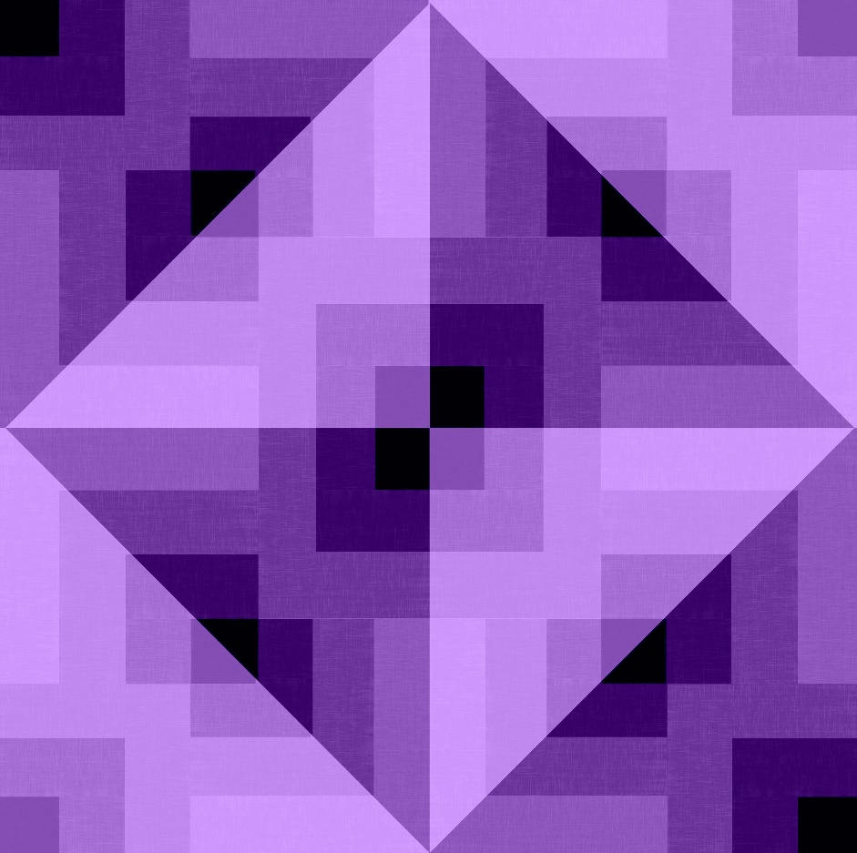
Live Demo
Shapes and Styles

Slide 16
Images
You can draw images on the canvas
Not all parameters are needed
Image resource
Source coordinates
ctx.drawImage(image,
sx, sy, sWidth, sHeight,
dx, dy, dWidth, dHeight);
Target coordinates
Draws whole image using original dimensions
ctx.drawImage(image, dx, dy);

Slide 17
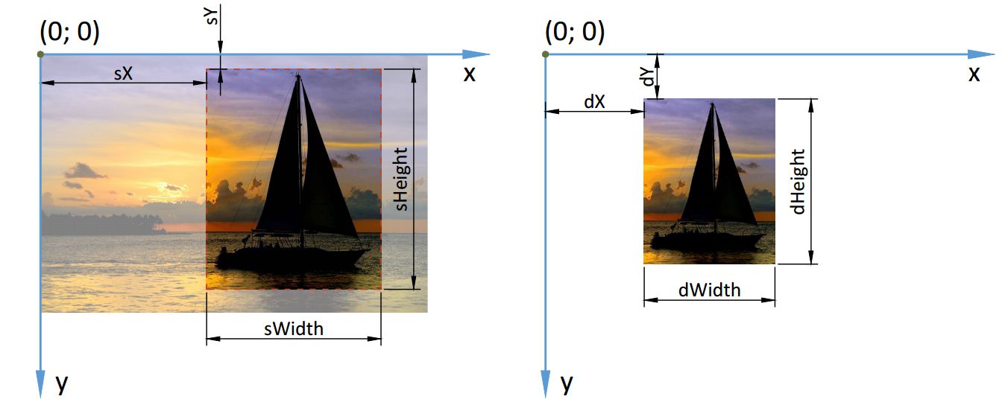
Images (2)
Source coordinates
Cropping an image
Destination coordinates

Slide 18
Drawing Text
Text can be outlined or filled, similar to other shapes
And customized:
ctx.font – changes the font type and size
ctx.textAlign – changes text alignment
ctx.fillText(text, x, y);
ctx.strokeText(text, x, y);

Slide 19
Example: Draw Button
Draw a button with a label
Draw button base
ctx.fillStyle = 'orange';
ctx.fillRect(30, 30, 200, 40);
ctx.fillStyle = 'white';
ctx.font = "24px monospace";
ctx.textAlign = 'center';
ctx.textBaseline = 'middle';
ctx.fillText("Submit", 130, 50);

Slide 20
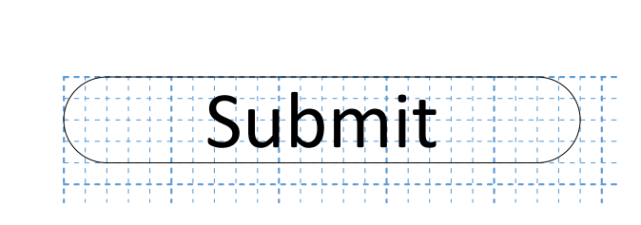
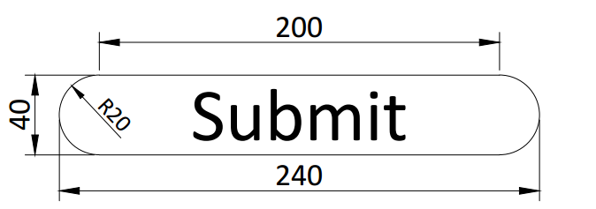
Problem: Rounded Button
Draw a button with a label and rounded edges

Slide 21
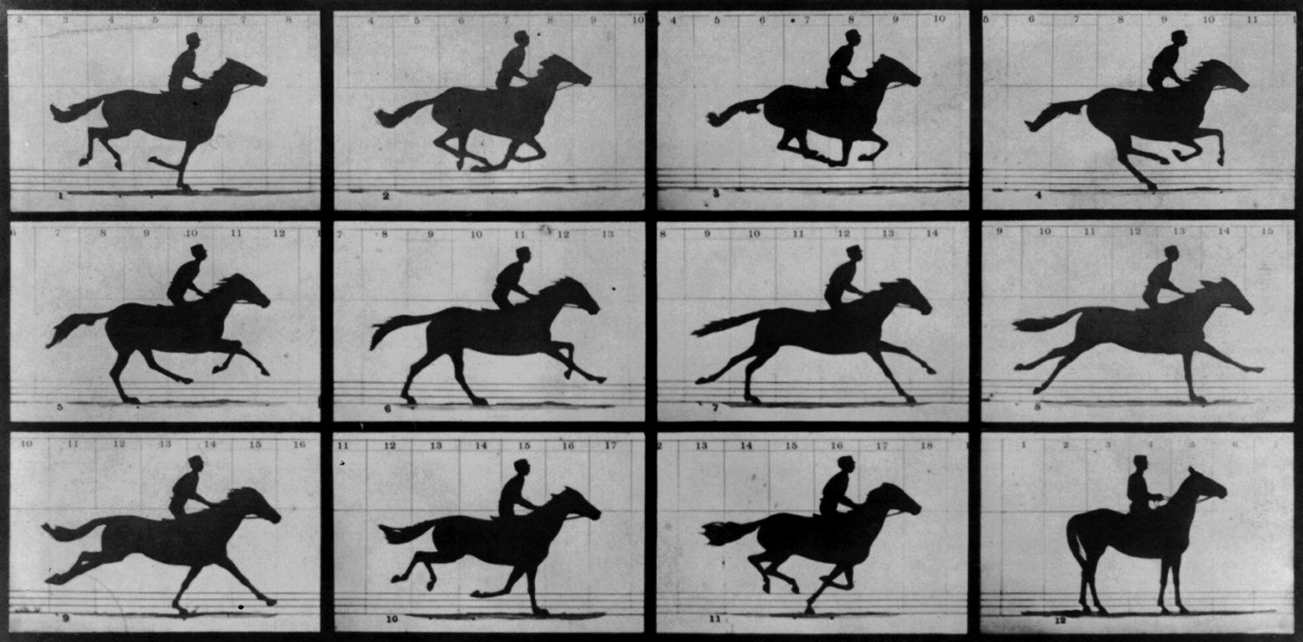
Animation with Canvas 2D
Creating Simple Animations

Slide 22
Animation Basics
Animation is achieved by gradually changing the contents of the canvas to smoothly morph it from one state to another
Most often, by changing the objects’ position
10
20
30
40
50

Slide 23
Animation Basics (2)
Timing (automatic redraw) is handled by the browser
setInterval(func, t) – execute every t milliseconds
requestAnimationFrame(func) – execute before the next frame draw
Example: loading bar

Slide 24
Animation Basics (3)
Clearing the canvas removes the previous frame
This allows movement to be simulated
We can clear the entire canvas or just parts of it
Example: Bouncing ball
ctx.clearRect(x, y, width, height);

Slide 25
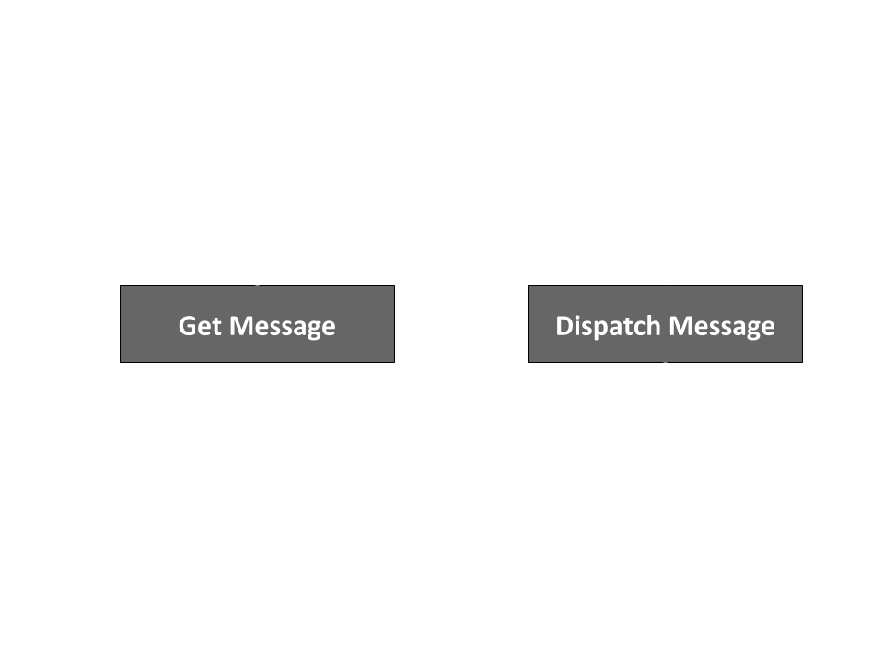
Handling Events
User Interaction with Keyboard / Mouse

Slide 26
Browser Events
Events are signals, sent from various sources
Buttons, keyboard presses, mouse movement/clicks
The browser can “listen” for events
A listener can be attached to any HTML object
The specified function is executed whenever an event of the correct type is registered
target.addEventListener(type, func);

Slide 27
Example: Animate on Button Press
HTML
JavaScript
<button type="button" id="drawBtn">Draw</button>
let btn = document.getElementById('drawBtn');
btn.addEventListener('click', animate);
function animate() {…}

Slide 28
Event Handler
The event handler function can take one parameter
The parameter holds information about the event
Useful when working with keyboard and mouse events
function handler(event) {
// Do stuff
}

Slide 29
Keyboard Events
keydown, keypress, keyup – detect keyboard event
event.code – string representation the key
Example: Move object with keyboard
function handler(event) {
if (event.code == "ArrowLeft") { position.x--; }
else if (event.code == "ArrowRight") { position.x++; }
}

Slide 30
Mouse Events
click, mousemove – detect mouse events
event.button – button pressed
event.clientX, event.clientY – coordinates
Example: Shoot ball towards mouse location
function handler(event) {
ball.x = 0; // Move ball to left edge
ball.y = event.clientY;
animate(); // Start animation
}

Slide 31
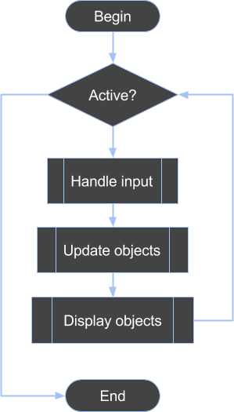
Game Loop
Tie It All Together

Slide 32
The Main Game Loop
Initialize
Check game state
Record button presses, mouse state
Process movement, physics, AI, etc.
Render
Cleanup

Slide 33
Sample Implementation
Define loop
function main() {
update();
render();
requestAnimationFrame(main);
}
function update() {…}
function render() {…}
requestAnimationFrame(main);
Main procedures
Start loop

Slide 34
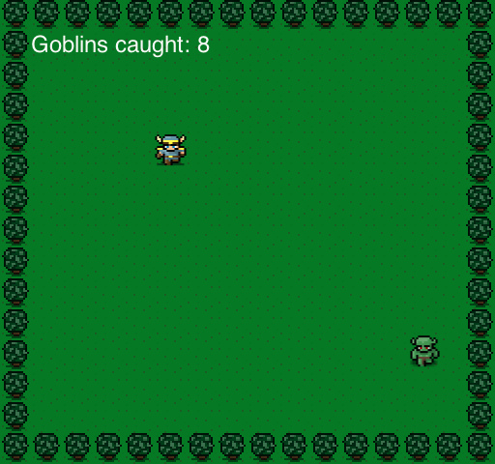
Live Demo
Creating a Game with Canvas 2D

Slide 35


Summary
Canvas API Basics
Simple Animation
Game Programming Patterns

Slide 36







Game Development with JS and Canvas 2D
https://softuni.bg/courses/

Slide 37
License
This course (slides, examples, demos, videos, homework, etc.) is licensed under the "Creative Commons Attribution-NonCommercial-ShareAlike 4.0 International" license

Slide 38





Free Trainings @ Software University
Software University Foundation – softuni.org
Software University – High-Quality Education, Profession and Job for Software Developers
softuni.bg
Software University @ Facebook
facebook.com/SoftwareUniversity
Software University Forums
forum.softuni.bg

